Slide 2
Hospital Management System(HMS) was introduced to solve the complications coming from managing all the paper works of every patient associated with the various departments of hospitalization with confidentiality. HMS provides the ability to manage all the paperwork in one place, reducing the work of staff in arranging and analysing the paperwork of the patients.
What is Hospital Management System ?

Slide 3
Main the medical Records of the Patients. Maintain the Contact Detail of the Patients. Keep track of the appointment Date. Tracking the Bill Payment.
What does Hospital Management System do?

Slide 4
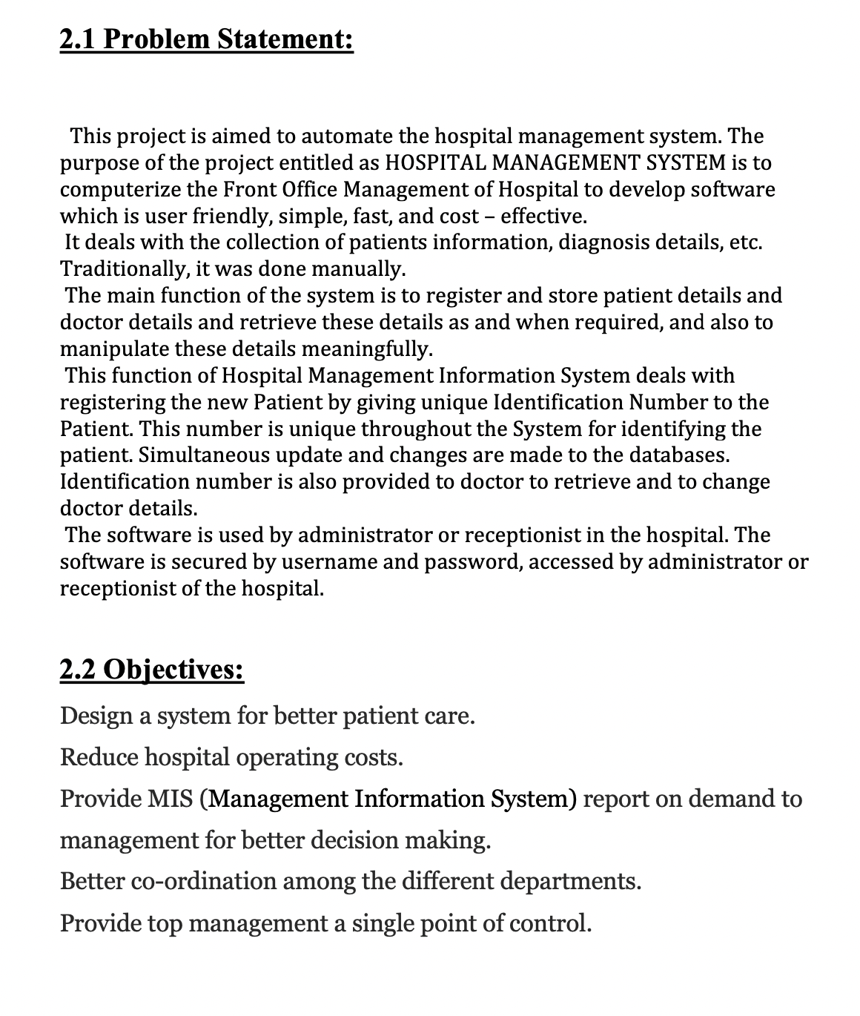
PROBLEM SOLVED

Slide 5
Advantages of Hospital Management System.
The advantages of HMS can be pinpointed to the following:
Time-saving Technology.
Improved Efficiency by avoiding human errors.
Reduces scope for Error.
Data security and correct data retrieval made possible.
Cost effective and easily manageable.
Easy access to patient data with correct patient history
Improved patient care made possible
Easy monitoring of supplies in inventory
Reduces the work of documentation
Better Audit controls and policy compliance.

Slide 6
Features of Hospital Management System.
Appointment Management
Billing Management
Prescription Management
Discharge Summary
Operation Theatre Management
Pharmacy Management
Increased Data security
Improved Quality Control
Ease to Access System Facilities
Cost Effective

Slide 7
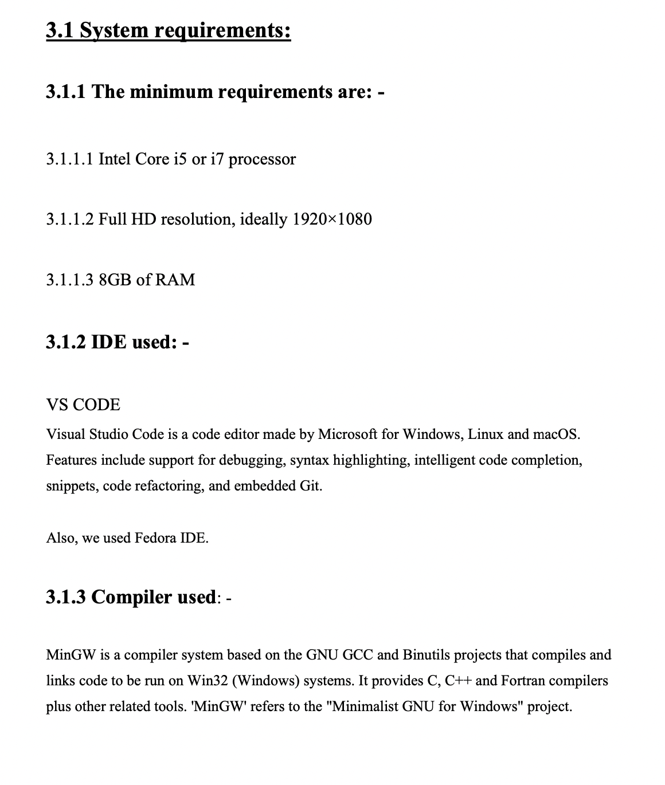
SYSTEM REQUIRMENTS

Slide 8
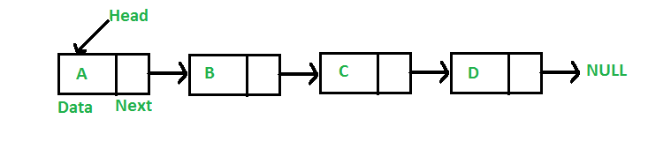
A linked list is a linear data structure, in which the elements are not stored at contiguous memory locations. The elements in a linked list are linked using pointers as shown in the below image:
Data Structure Used-
Linked List

Slide 9
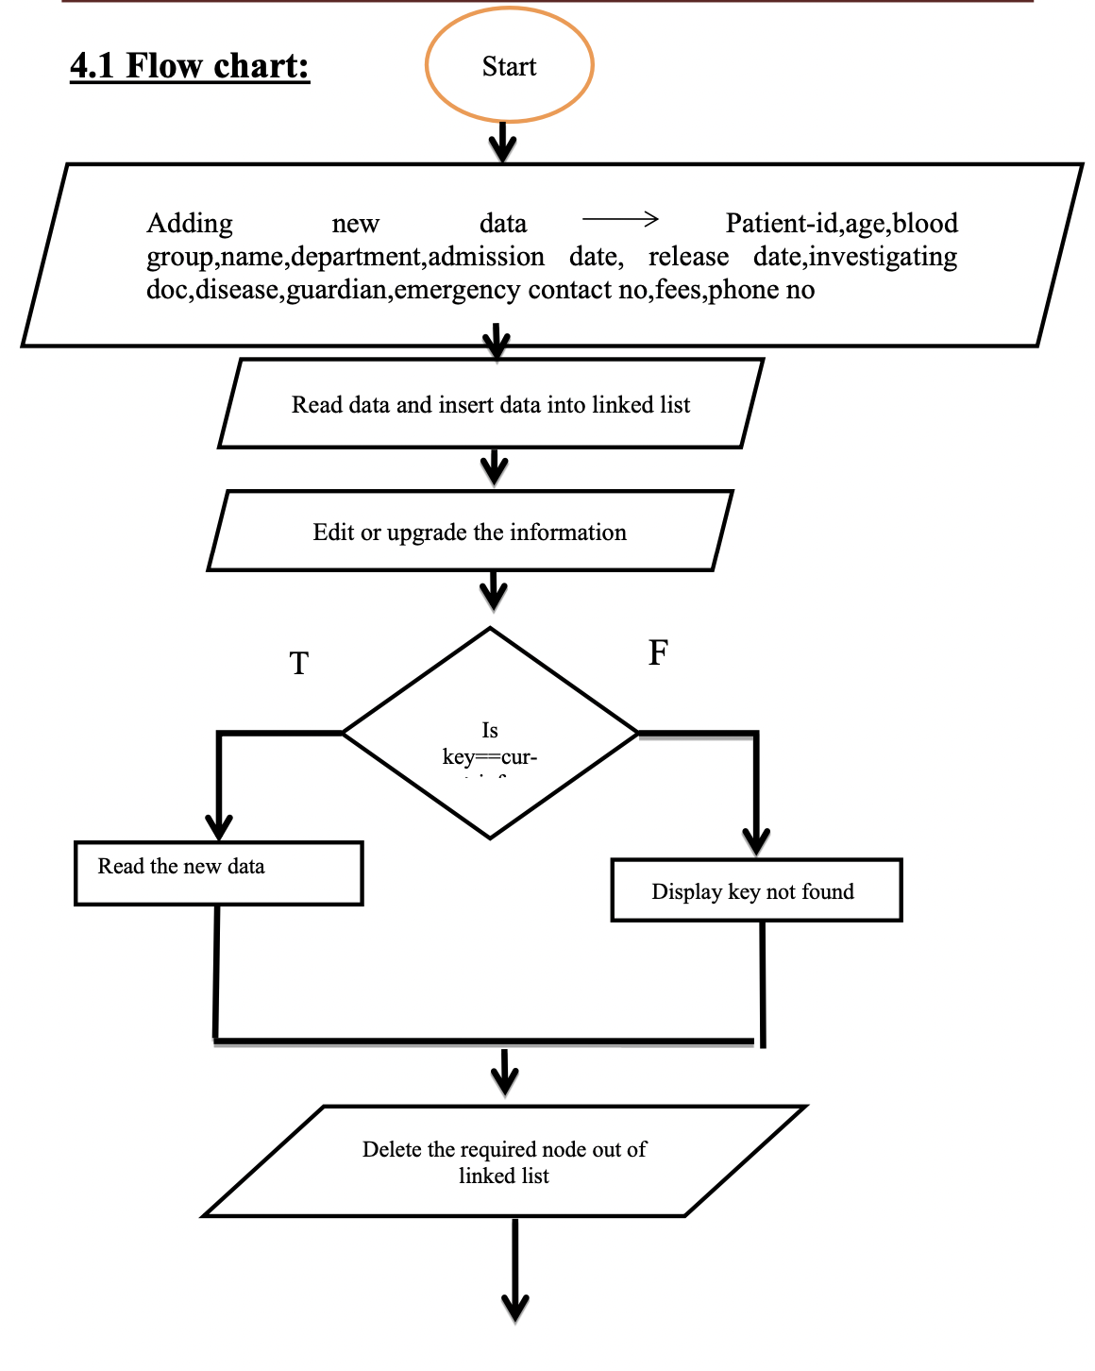
Flow chart

Slide 10
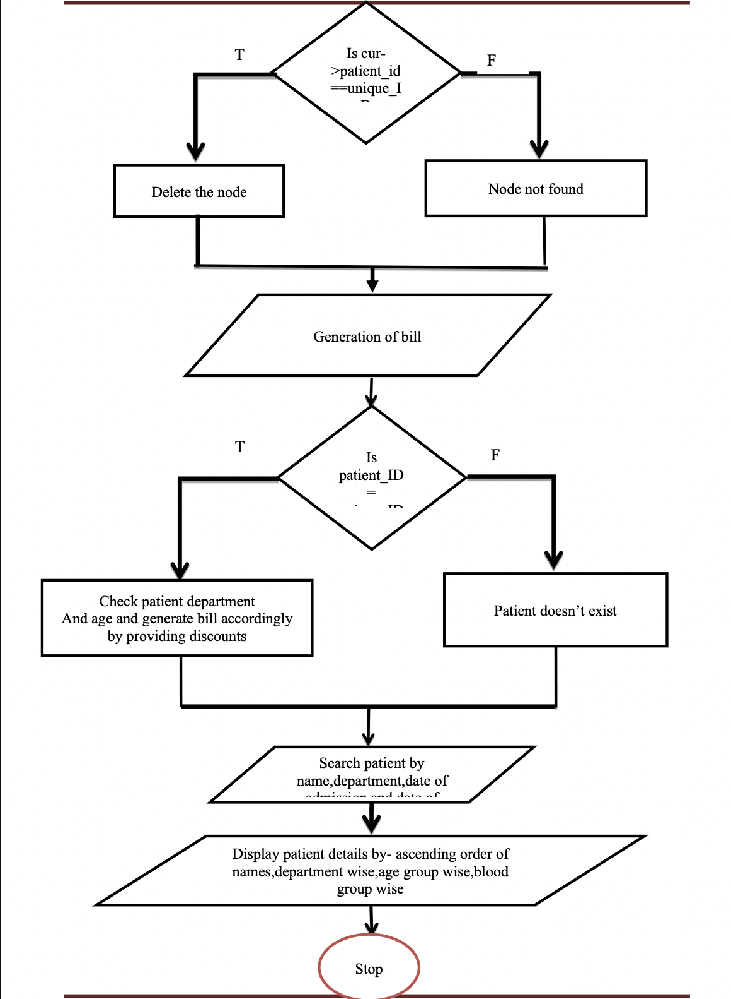

Slide 11
Algorithm
Start
Create Node
Step 1 – create a structure of struct patient details .
Step 2 – declare data type whatever you want inside structure .
Read function:
Step 1 – get input of patient details from user .
Step 2 – store the data .
Insert function:
Step 1 – Declare a node of student details q and last .
Step 2 – allocate memory for q .
Step 3 – increment the patient id by 1 .
Step 4 – insert the patient details in the q node , by STRCPY function or any other int function .
Step 5 – if first is equal to NULL then q is next is equals to q and q previous is equals to q .
Step 6 - else link to q to last and first and then assign first = q .

Slide 12
Count No. of Days function:
Step 1 – Check for leap year .
Step 2 – if month is same then diff = date of admission – date of release .
Step 3 – for first month calculate diff = no of days in month - date of admission .
Step 4 -for no of months add no of days in diff accn to month.
Step 5 – for last month diff = diff + date of release .
Step 6 -return (diff + 1)
Billing function:
Step 1 – take diff (no of days).
Step 2 – Check dept of patient .
Step 3 – calculate fare accn to no of days and dept.
Step 4 – check for age discount ,calculate tax.
Step 5 – total fair =total fair + tax.
Display Function
Step 1 – - Define a node current which initially points to the head of the list.
Step 2 – Traverse through the list till current points to first
Step 3-Display each node by making current to point to node next to it in each iteration.
End

Slide 13
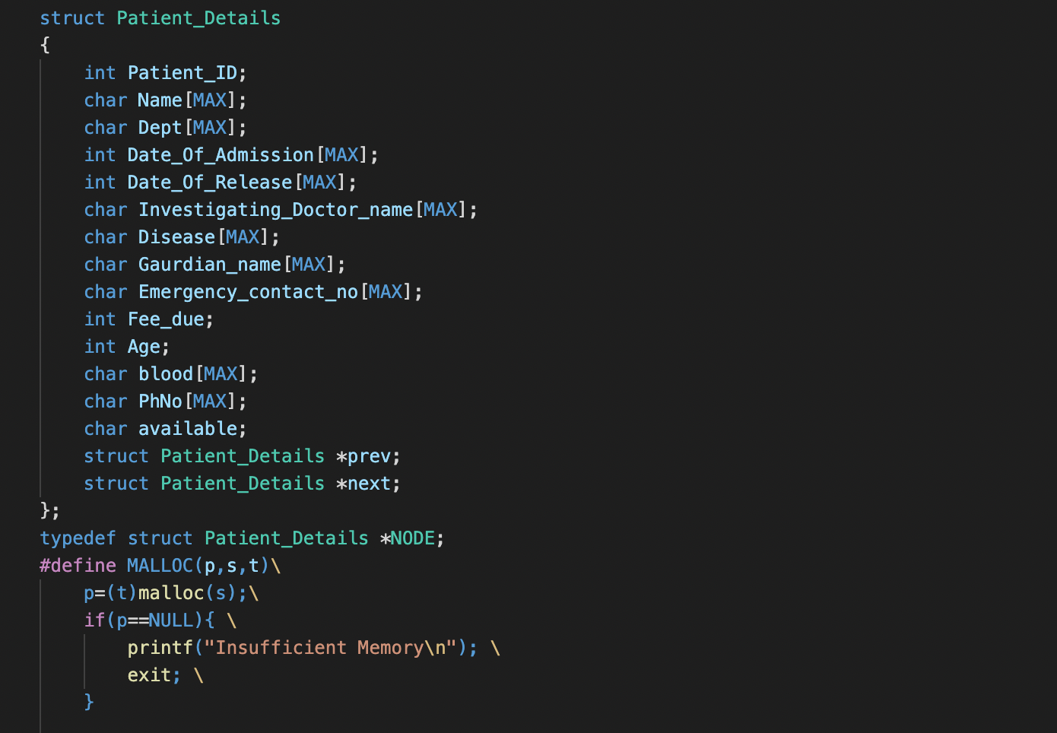
Creating a NODE

Slide 14
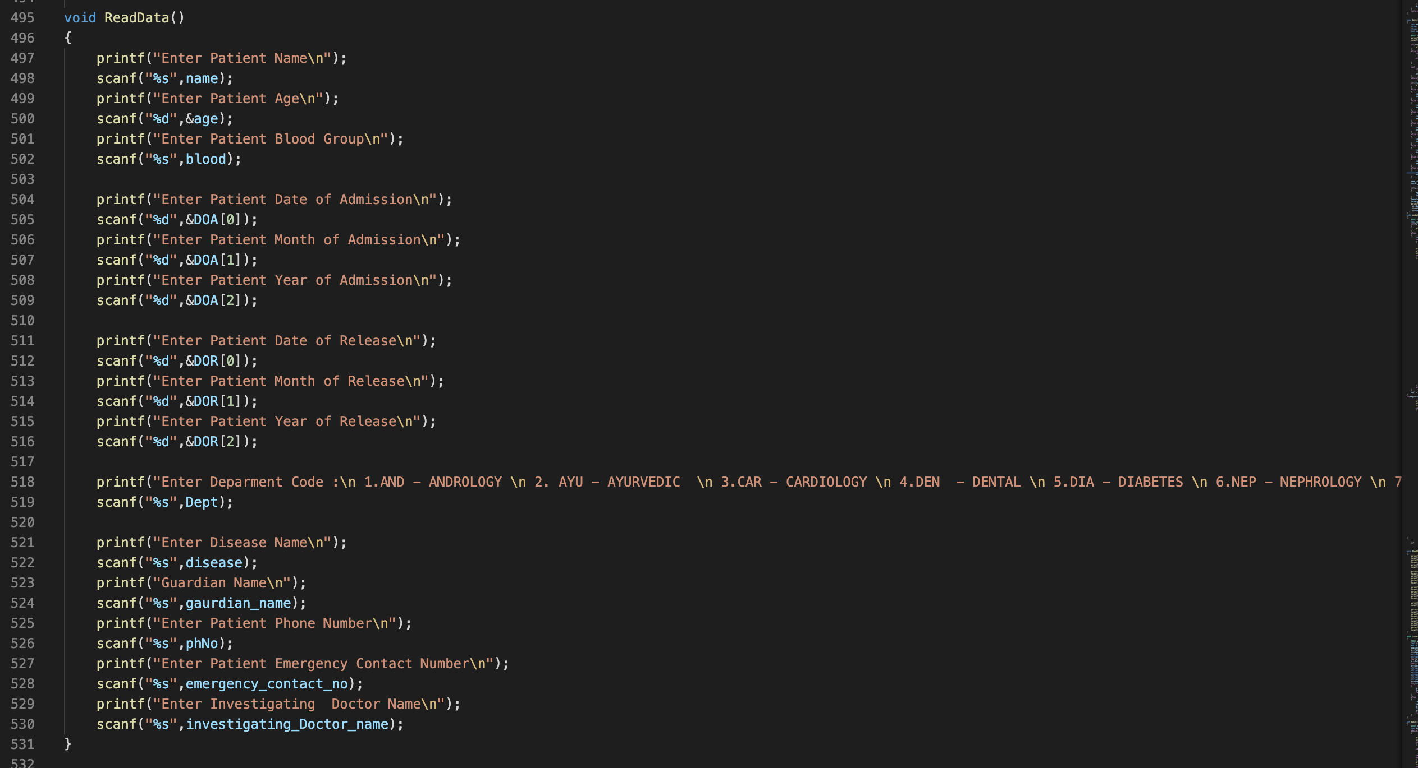
Read Data

Slide 15
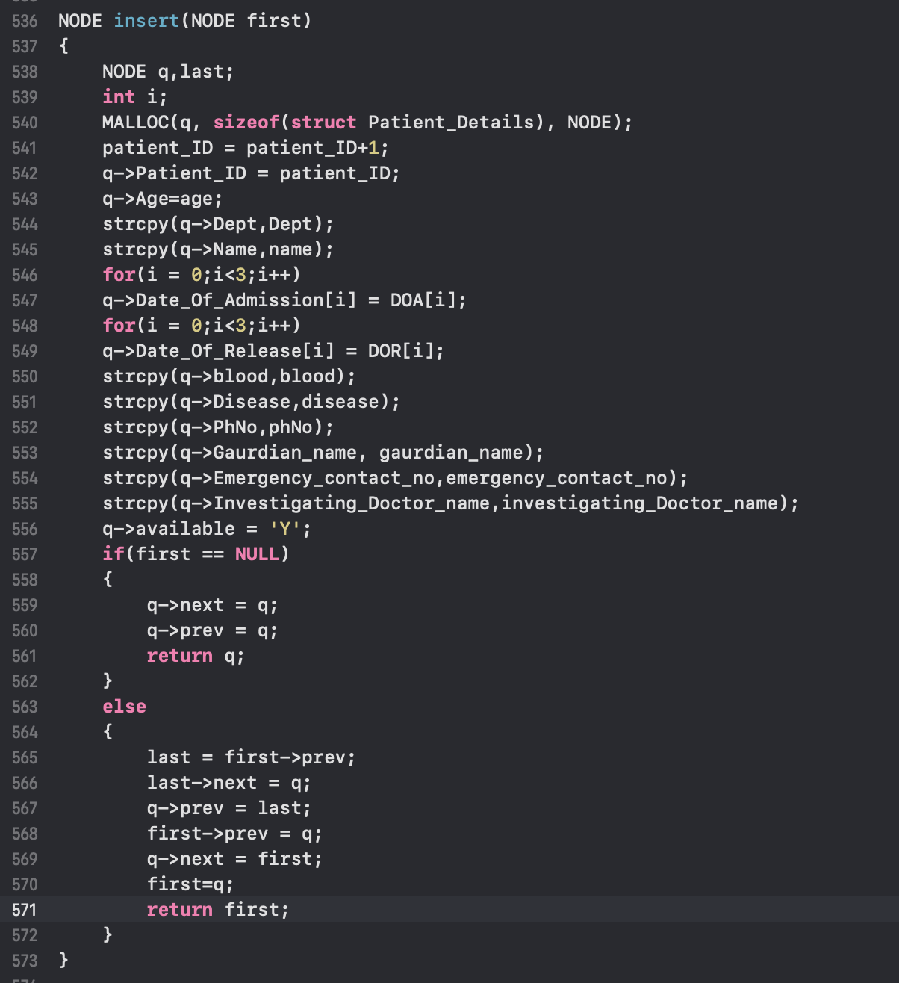
Inserting Information

Slide 16
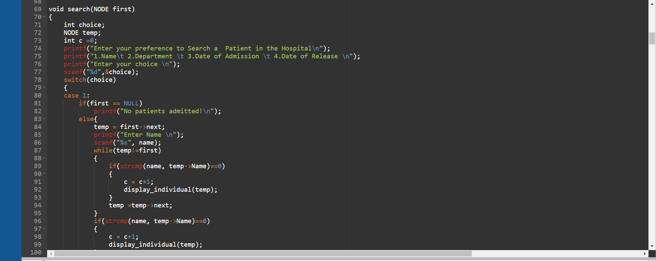
Searching Function.

Slide 17
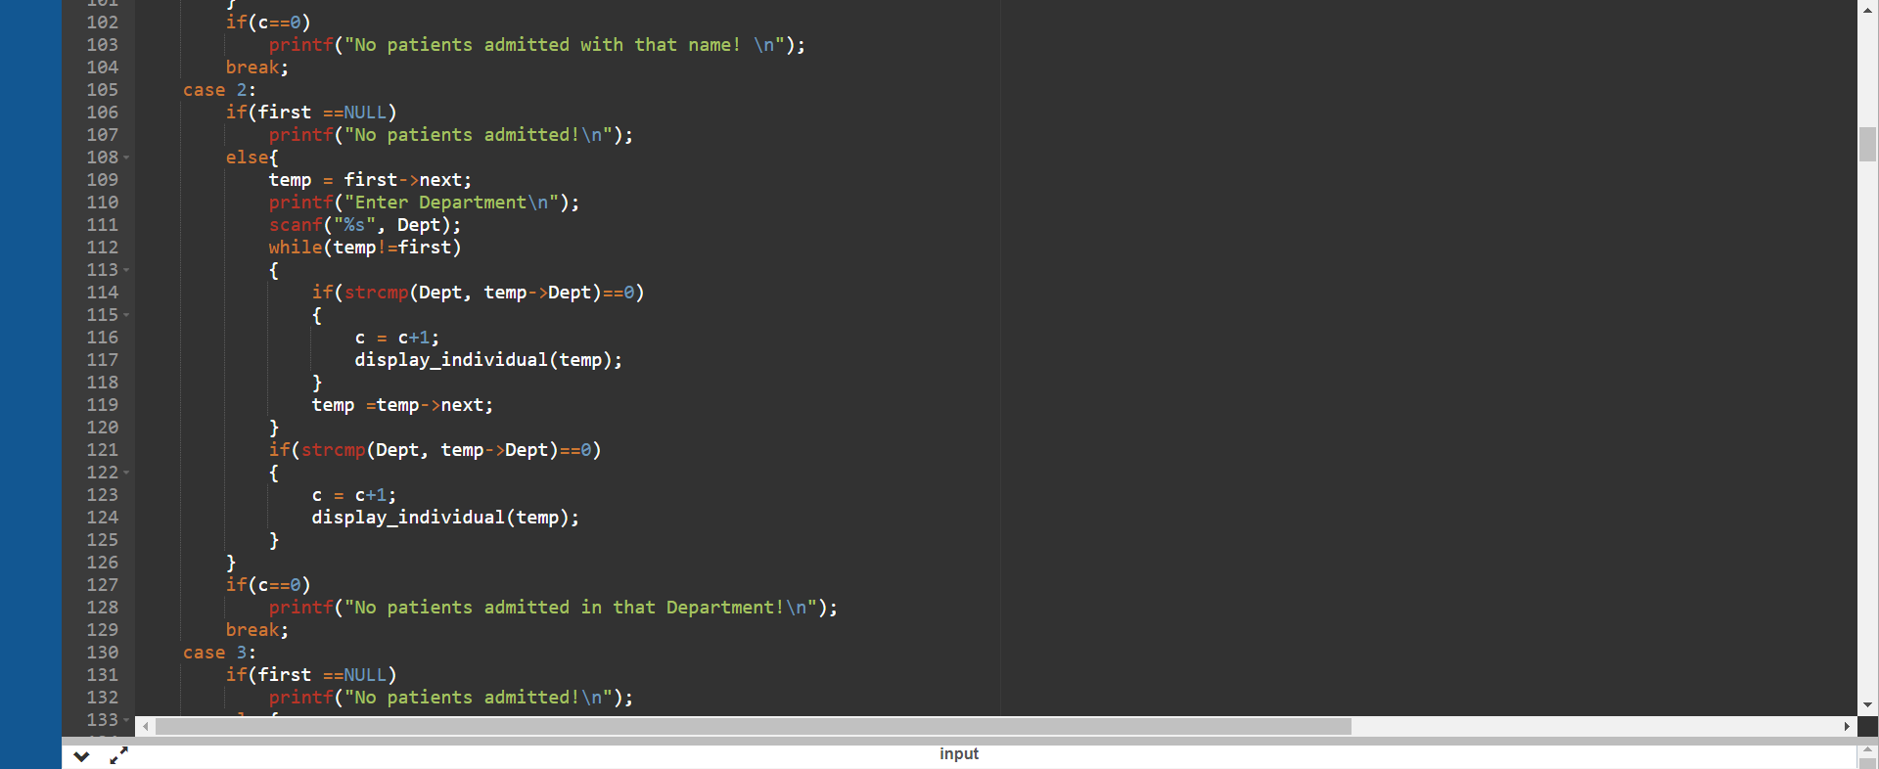
Searching Function.

Slide 18
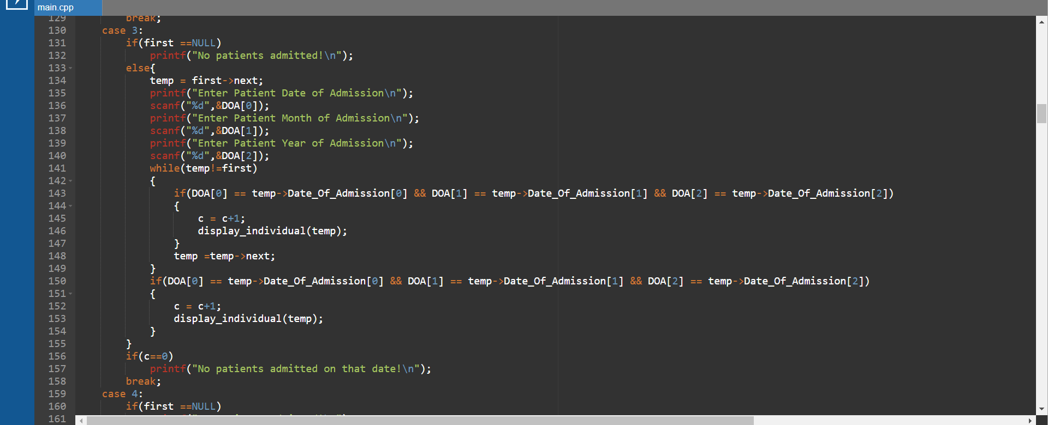
Searching Function.

Slide 19
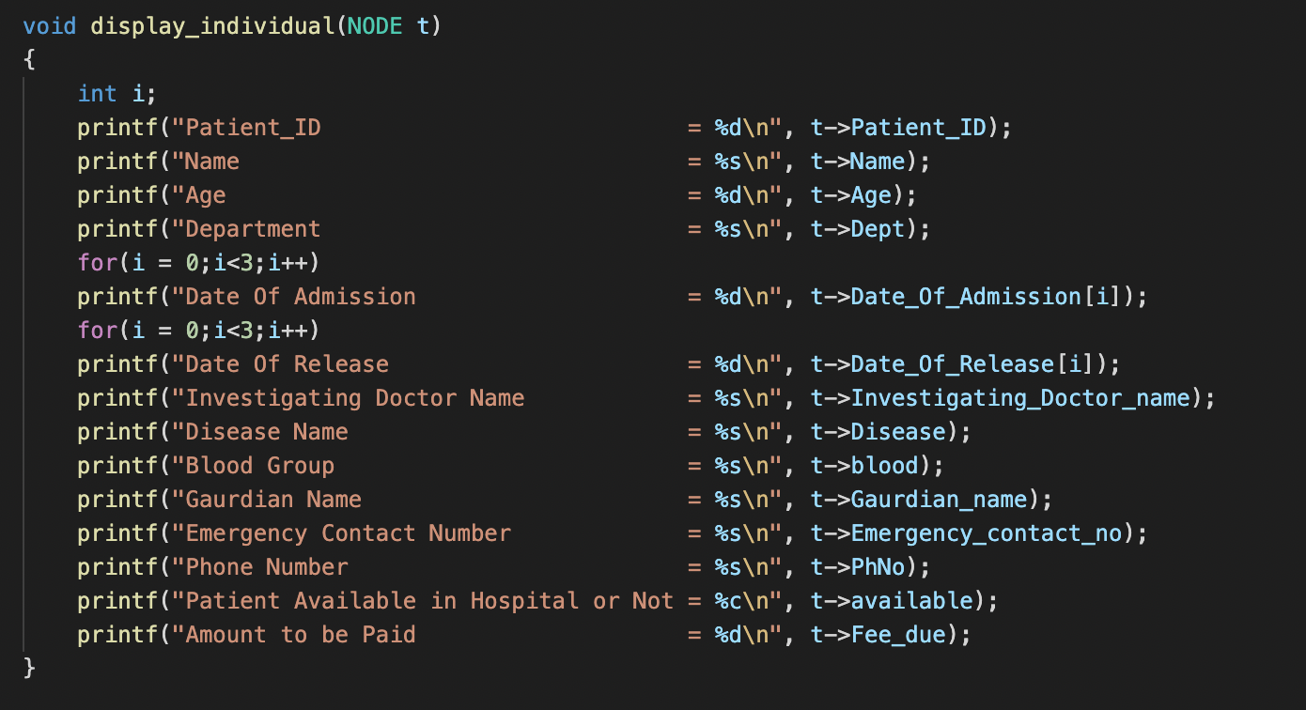
Display Function

Slide 20
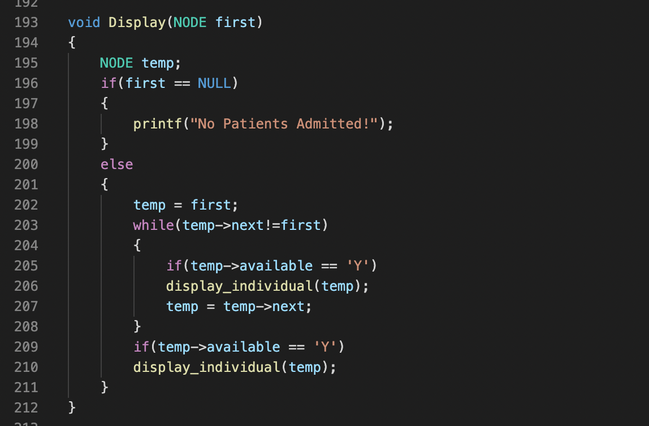
Display Function

Slide 21
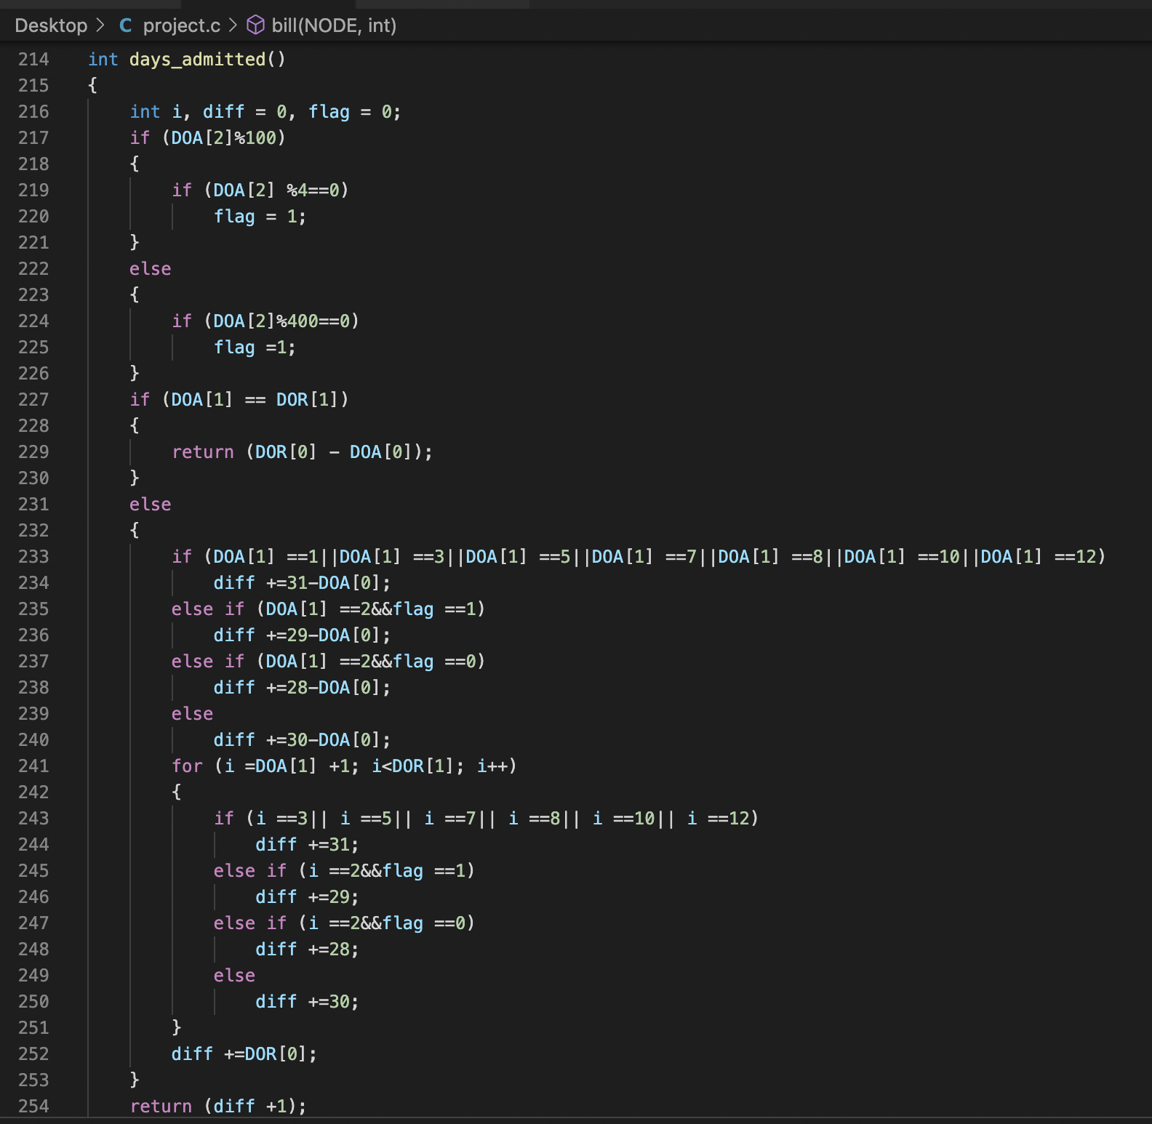
Days of Addmission

Slide 22
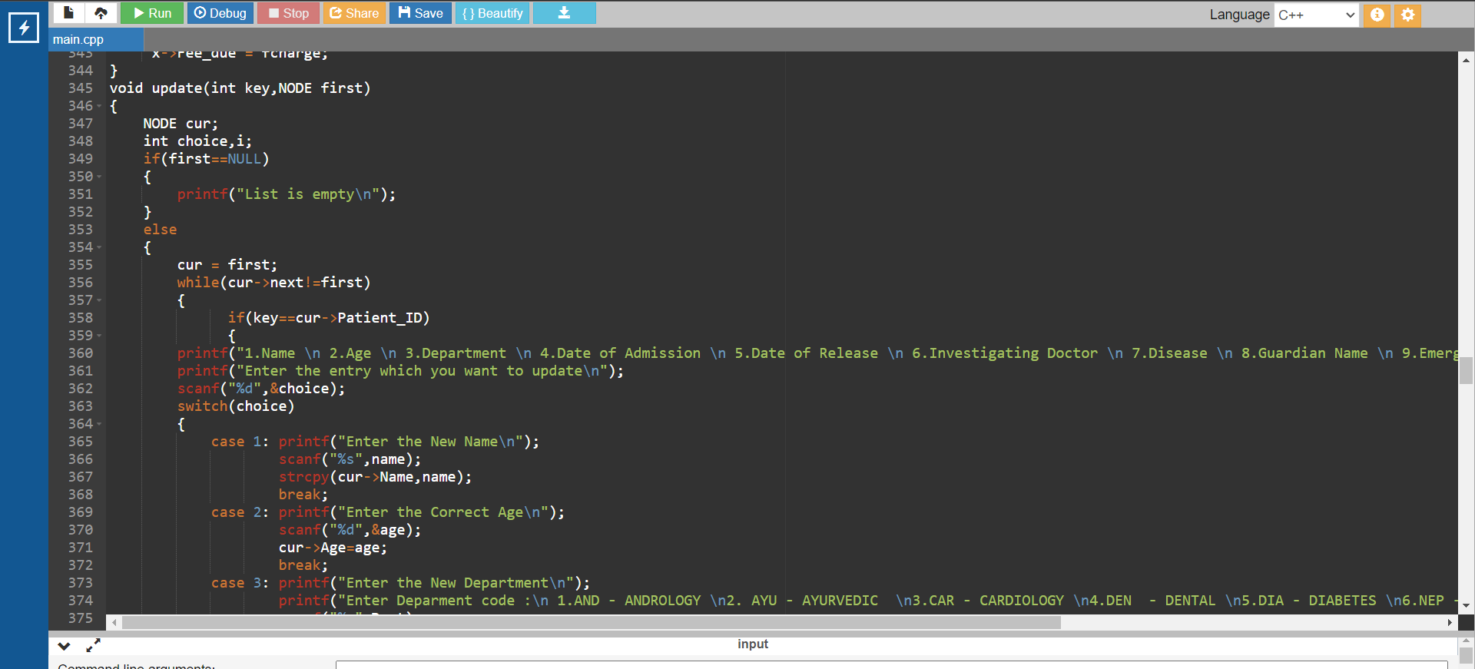
Updating Function.

Slide 23
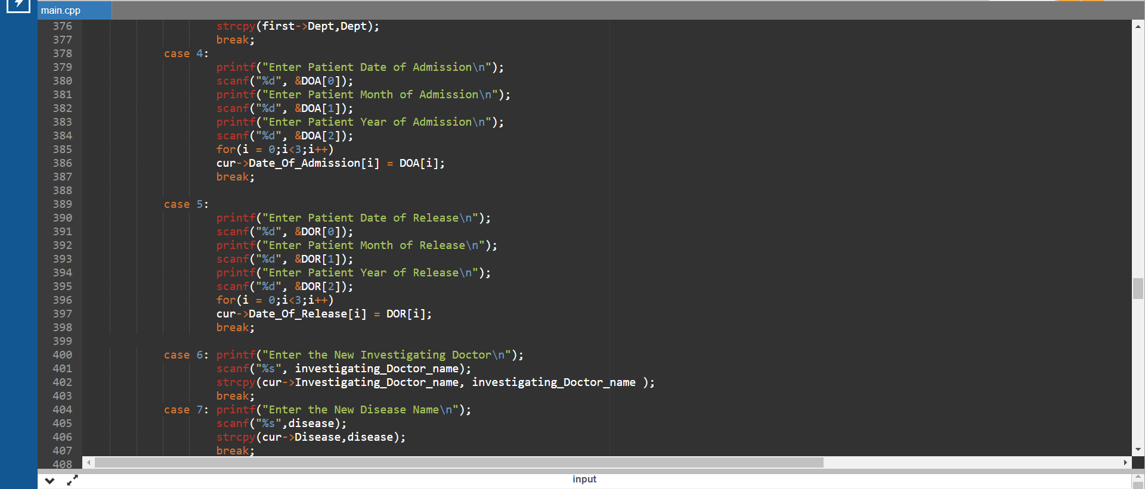
Updating Function.

Slide 24
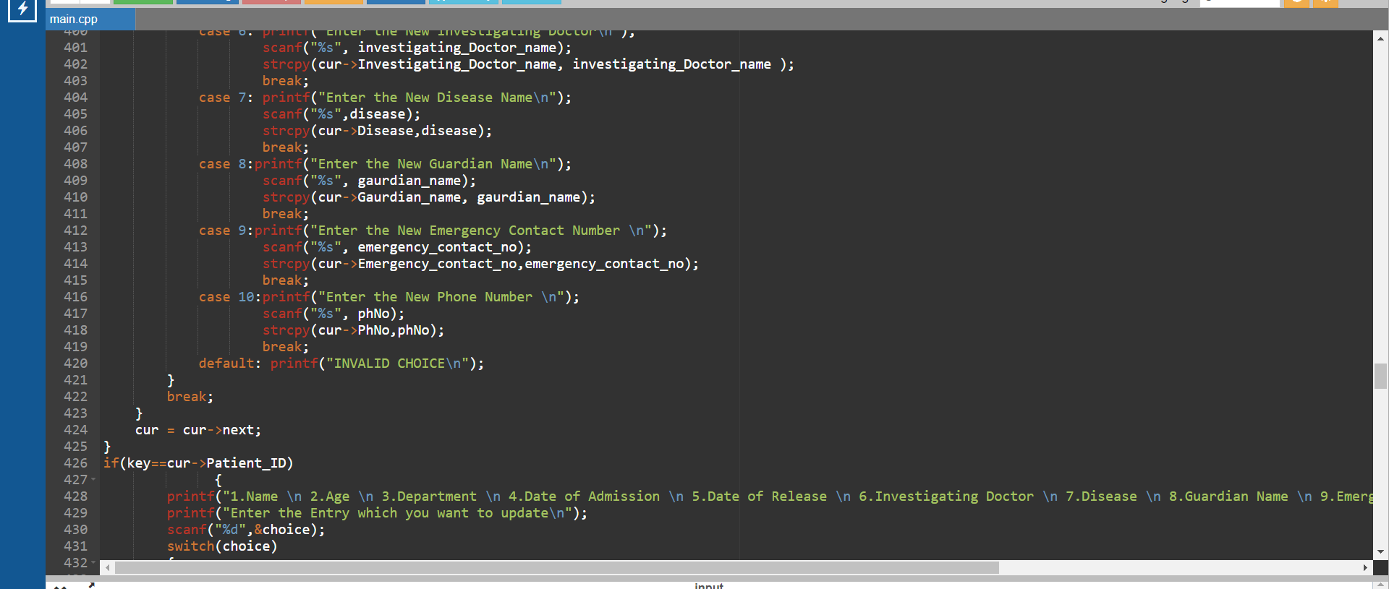
Updating Function.

Slide 25
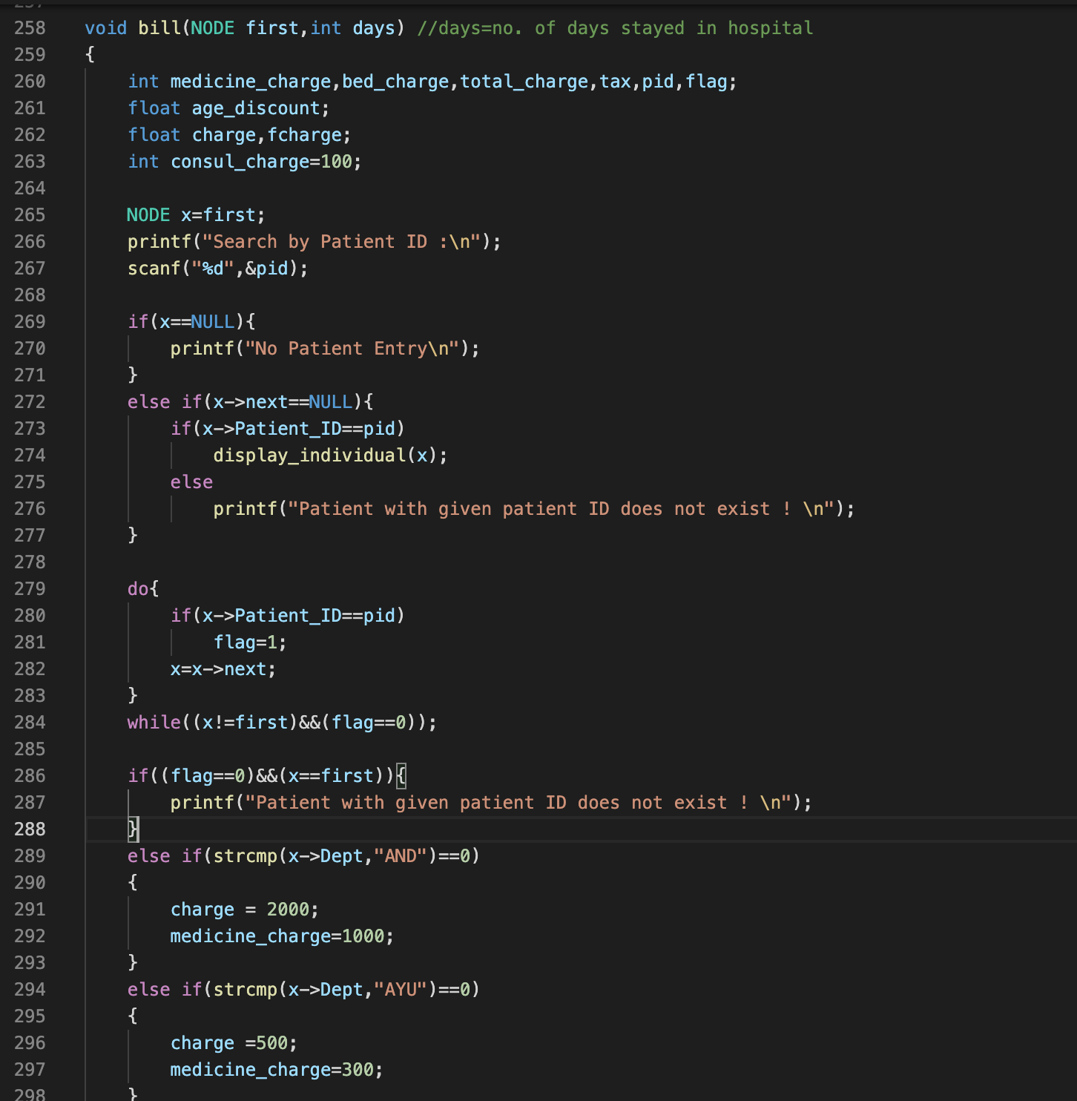
Generating a Bill

Slide 26
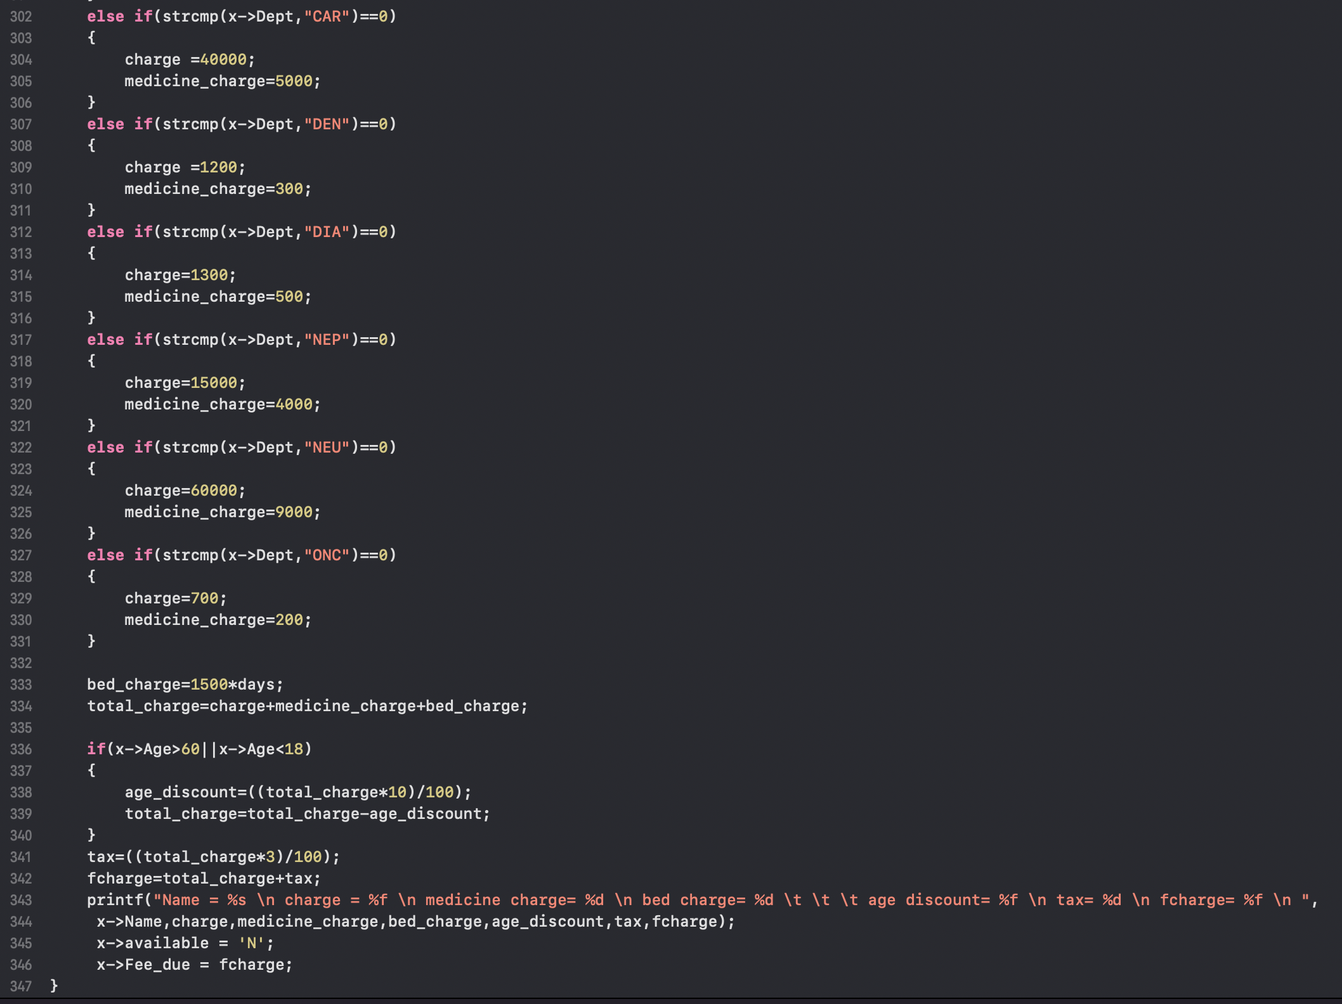
Generating Bill
Continue

Slide 27
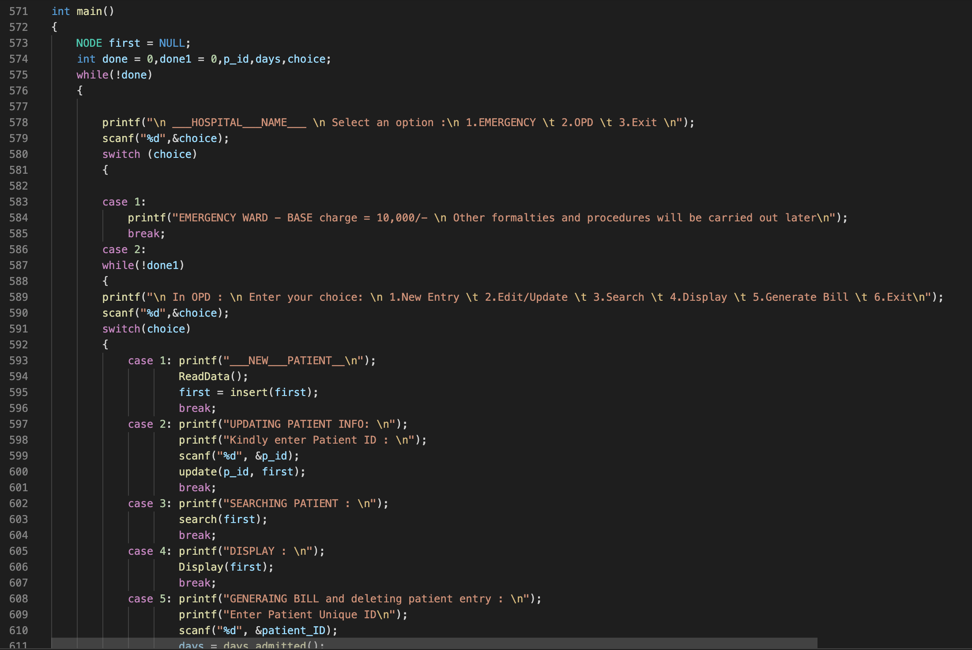
Main Function

Slide 28
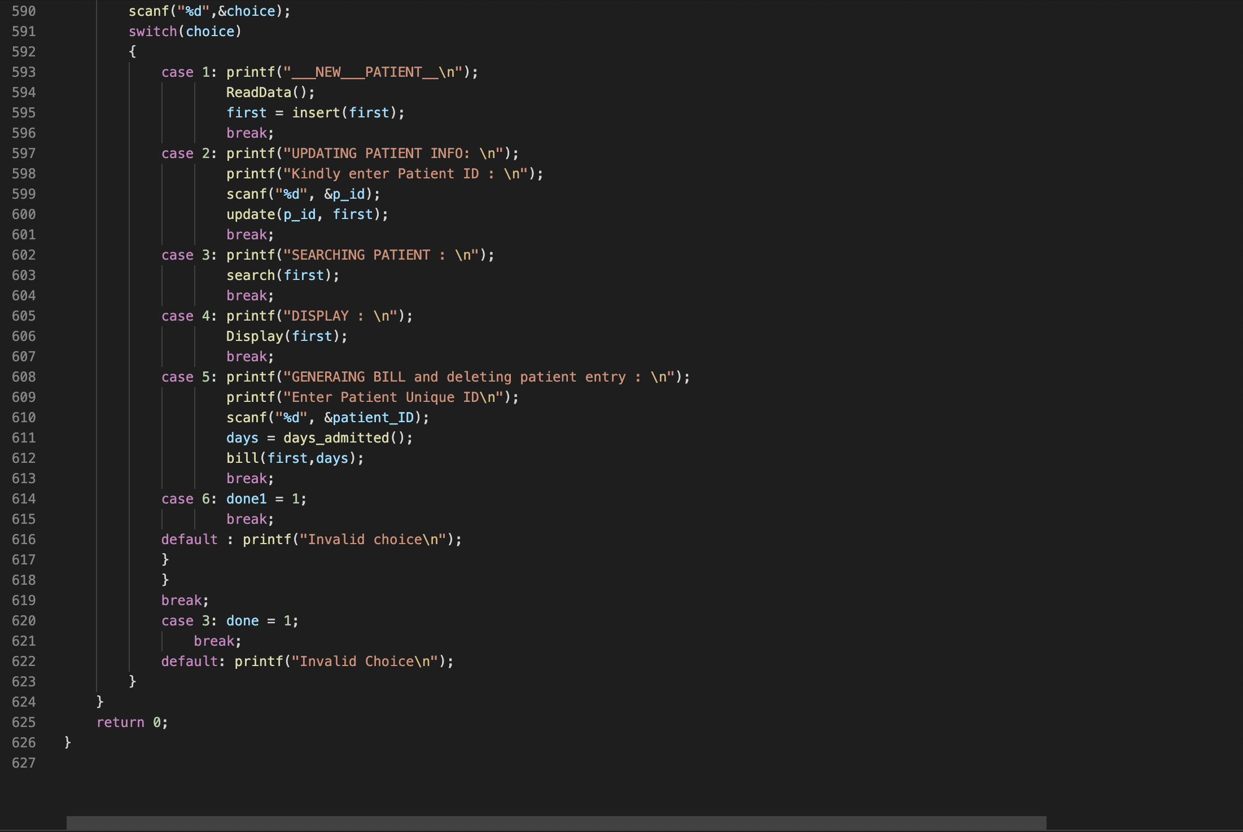
Main Function

Slide 29
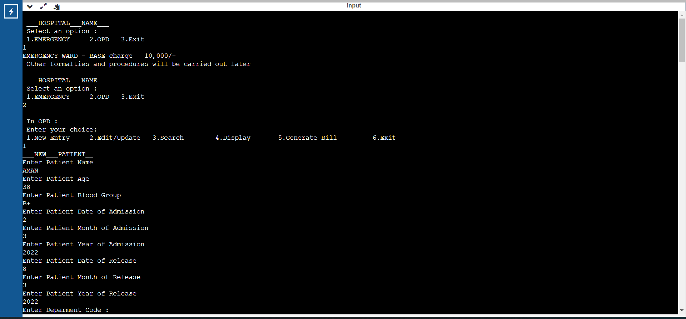
Outputs

Slide 30
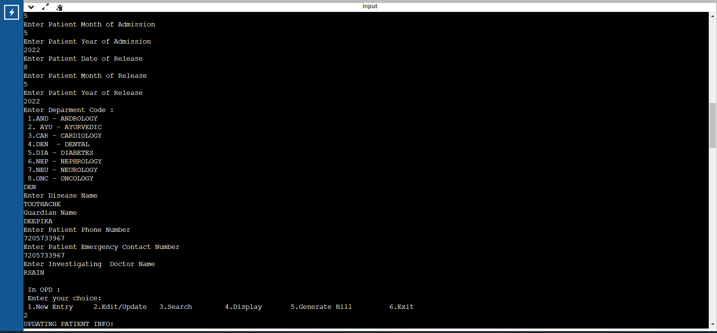
Outputs

Slide 31
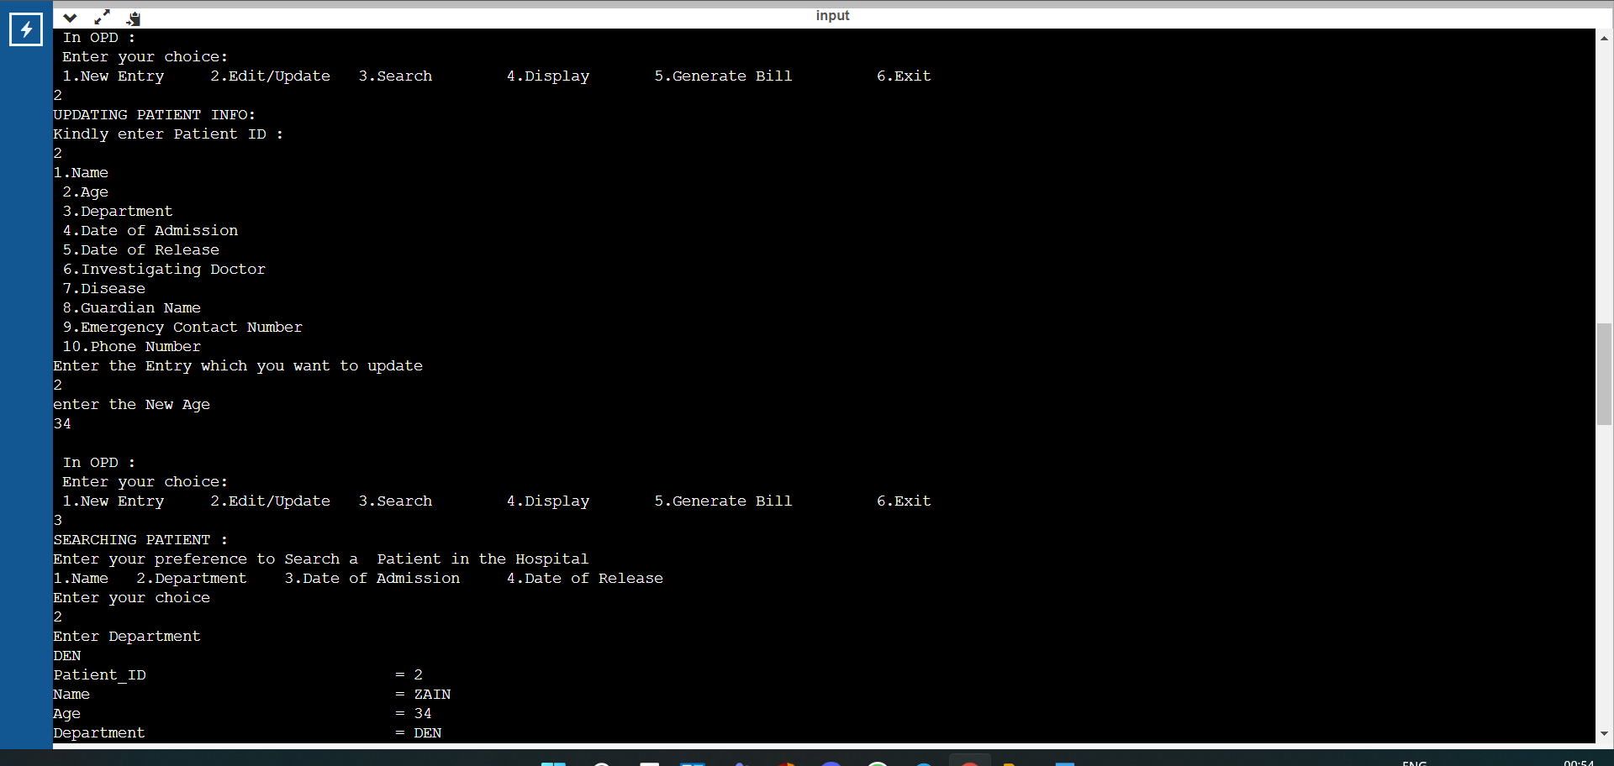
Outputs

Slide 32
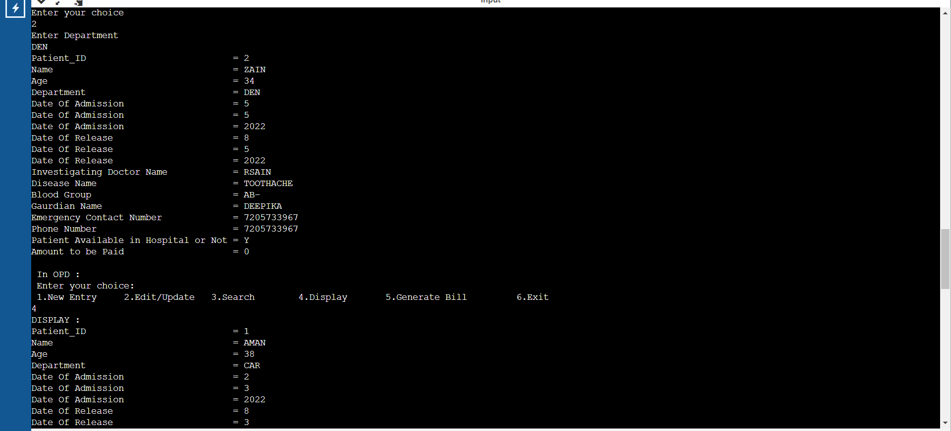
Outputs

Slide 33
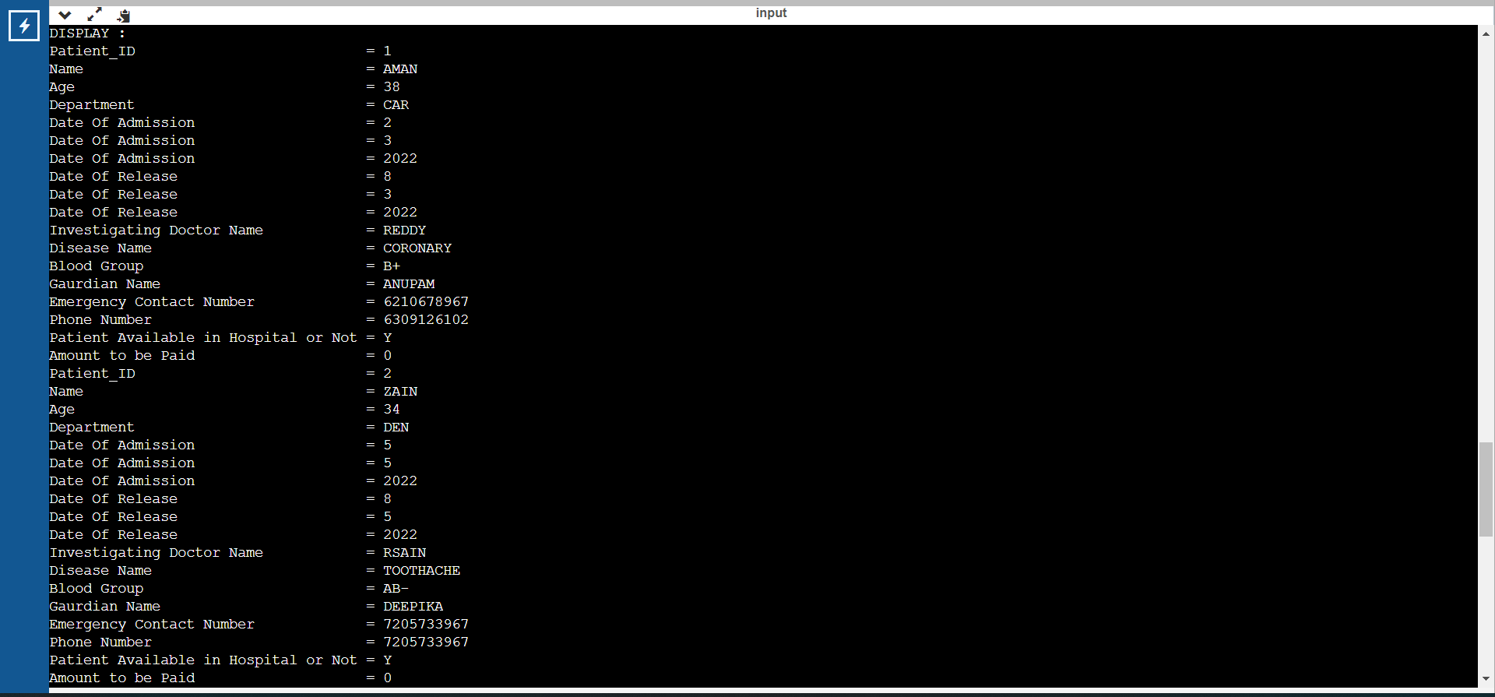
Outputs

Slide 34
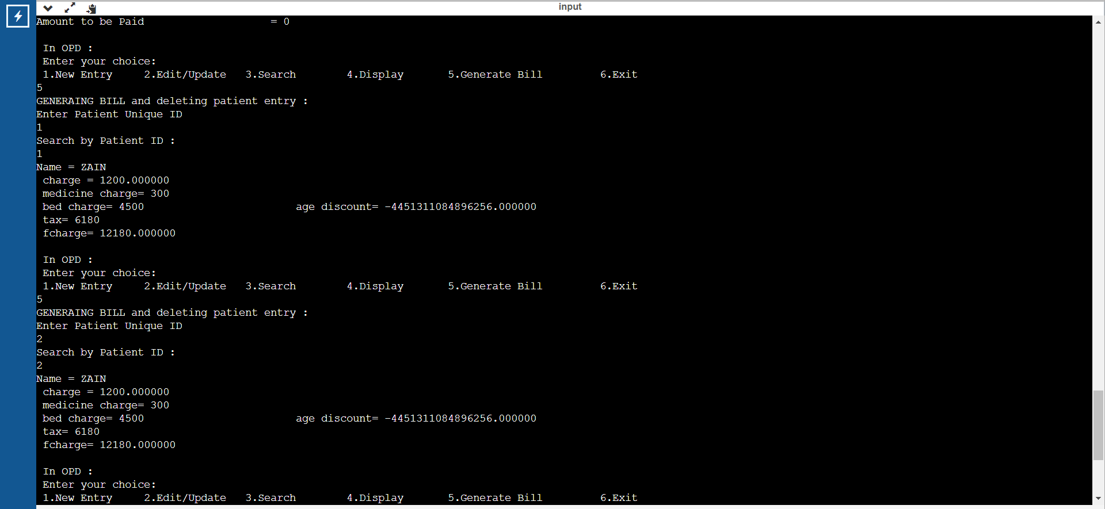
Outputs

Slide 35
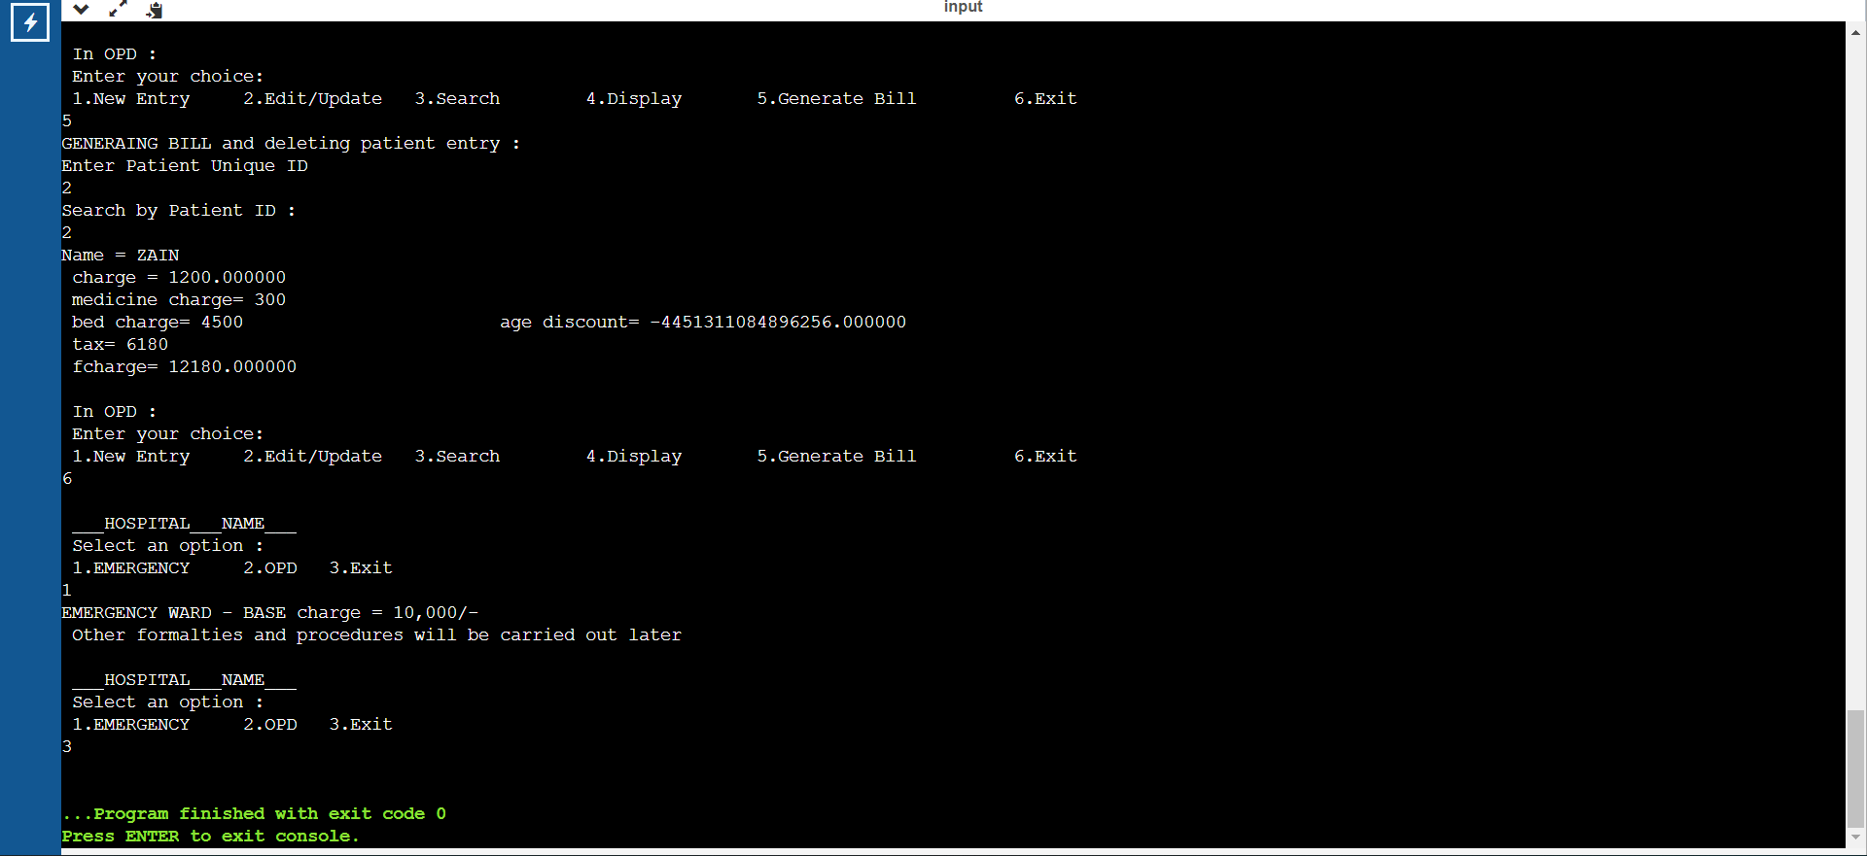
Outputs

Slide 36
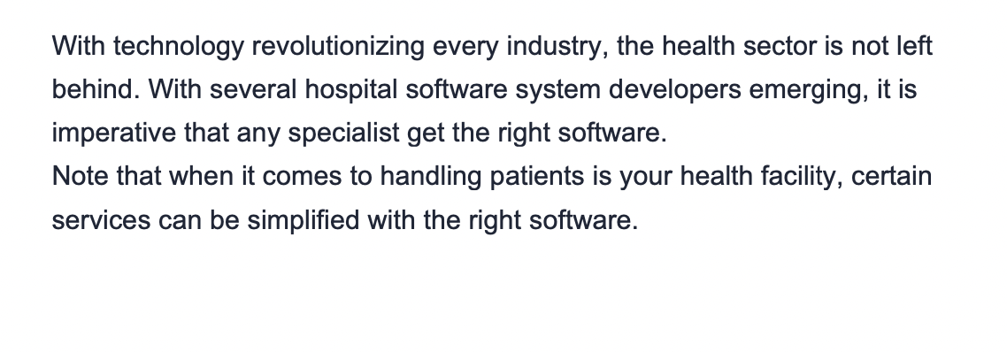
APPLICATIONS

Slide 37
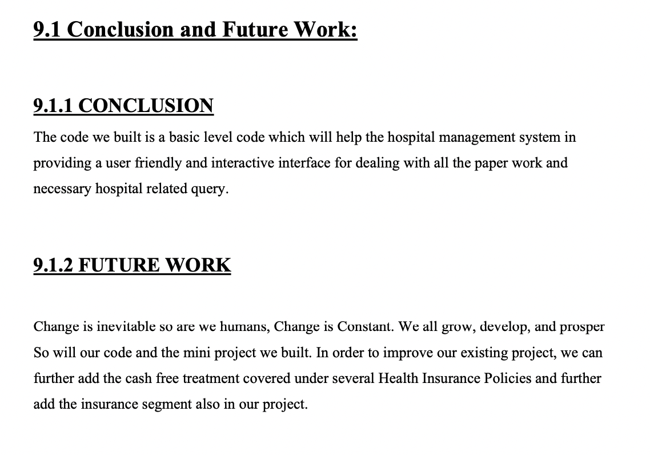
CONCLUSION

Slide 38
CREATED BY
ABHINAV KUMAR 1BI20CS003
PRADDYUMNA KANDALKAR 1BI20CS086
DHEERAJ KATOCH 1BI20CS057
DARSHAN PASARGI 1BI20CS050
VIVEK GUPTA 1BI20CS189

Slide 39
THANK YOU !!

